Slide 1
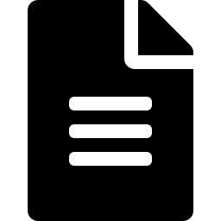




MORINGA SCHOOL
AI-Powered Audit
Document Tracking &
Follow-up
Week 10 Capstone Project
Dennis Paul · Leilah Kokoyo
Workflow Automation Programme
n8n · Mistral AI · Google Sheets · Gmail ·
Notes:
Welcome everyone. This is our Week 10 Capstone Project presenting an AI-powered audit document tracking and risk management system. The system was developed by Dennis Paul and Leilah Kokoyo and built using n8n workflow automation, Mistral AI, Google Sheets, Gmail.

Slide 2



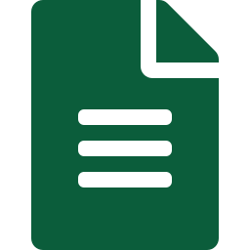

PROBLEM STATEMENT
The Problem
Dennis Paul and Associates Audit Firm spends significant time manually tracking outstanding client documents, creating costly inefficiencies.
Delayed Submissions
Manual Follow-ups
Inconsistent Risk Scoring
Missed Deadlines
No Central Monitoring
Clients miss deadlines with no automated alerts
Staff spend hours chasing documents by phone/email
Risk assessed subjectively, not systematically
Audit timelines slip due to missing documents
No single view of all outstanding submissions
Up to 40% of audit time
Risk of regulatory issues
Manual processes = errors
spent on document chasing
from inconsistent follow-up
and delayed audit completion
Notes:
The core problem we identified at Dennis Paul and Associates was that audit teams were spending significant time manually tracking documents from clients. Five key challenges emerged: delayed submissions with no automated alerts, staff spending hours on manual phone and email follow-ups, inconsistent risk assessment based on personal judgment, missed audit deadlines, and no central visibility of all outstanding submissions. Industry research suggests up to 40% of audit time can be spent on this type of administrative work.

Slide 3



INSPIRATION
Project
Inspiration
Auditors often spend valuable time chasing clients for missing documents instead of focusing on analysis and assurance work.
"What if the system could track, classify, and remind, automatically?"
BEFORE
📋 Manual spreadsheet tracking
📞 Phone call reminders
Our Goal
📧 Individual emails per client
Automate repetitive follow-ups while improving visibility and risk management using AI — freeing auditors to focus on higher-value analytical work.
⏰ Missed follow-up deadlines
❌ Inconsistent risk scoring
AFTER
AI classifies risk automatically
Smart emails drafted & approved
Human oversight before sending
Notes:
Our inspiration came from Dennis Audit firm who happens to be my partner in this project. Dennis could ask: what if the entire document follow-up process could be automated? Our goal was to build an intelligent system that tracks documents, assesses risk using AI, drafts professional reminder emails, and routes them through a human approval gate before sending all running automatically every morning.

Slide 4






PROPOSED SOLUTION
Our Solution
An AI-powered n8n workflow that automates the full audit document tracking lifecycle:
Document Monitoring
Risk Classification
Smart Email Drafting
Reads Google Sheets daily, filters pending submissions automatically
AI classifies Low / Medium / High risk based on days overdue
The second AI agent writes tone-adjusted emails per client
Approval Gate
Automated Logging
Error Handling
The manager reviews and approves before any email reaches a client
Updates Google Sheets with outcomes automatically
Separate AI-powered error workflow alerts the team of failures
Built with n8n · Mistral AI · Google Sheets · Gmail
Notes:
Our solution is a six-component automated workflow. It monitors Google Sheets for pending documents, uses an AI Classifier Agent to score risk as Low, Medium, or High based on days overdue, uses a second Email Drafter Agent to write tone-appropriate reminders, passes them through a manager approval gate before sending, logs all outcomes to Google Sheets, and has a separate error-handling workflow powered by AI that alerts the team if anything fails.

Slide 5

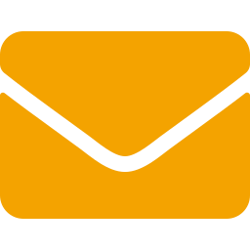


SYSTEM ARCHITECTURE
How the System Works
1
2
3
4
5
6
7
▶
▶
▶
▶
▶
▶
Google Sheets
Overdue Days
AI Classifier
Email Drafter
Manager Approval
Client Notified
Audit Log
Audit Tracker
Calculated
Risk Assessment
AI-Generated
Human Gate
Email Sent
Sheets
= Manager apprapprovalate (human oversight)
Powered by: n8n Workflow Automation · Mistral AI · Google Sheets API · Gmail API ·
Notes:
This slide shows the complete system architecture. The workflow starts with the Schedule Trigger reading from Google Sheets at 8am daily. It calculates overdue days, filters only truly overdue records, runs them through the AI Classifier Agent which scores risk as Low, Medium, or High. The Email Drafter Agent then writes a tone-matched email. High and Medium risk emails go through a manager approval gate — the manager receives an email with approve or reject links. Once approved, the client email is sent and all outcomes are logged in both Google Sheets.

Slide 6



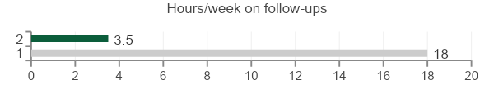
KEY FEATURES & RESULTS
Business Value
KEY FEATURES
BUSINESS BENEFITS
Automated document monitoring
↓ 80%
10x
AI risk classification (Low / Medium / High)
Reduction in manual follow-up time
Faster client document reminders
Smart AI email generation
3 Levels
100%
Approval-based communication gate
Consistent AI risk classification
Human oversight before client emails
AI-powered error handling workflow
Notes:
The business value is significant. The five key features — automated monitoring, AI risk classification, smart email drafting, a human approval gate, and error handling — combine to deliver measurable benefits. We estimate an 80% reduction in manual follow-up time, 10x faster response to overdue documents, and consistent three-level risk classification across all clients. Crucially, the manager retains 100% oversight before any email reaches a client — this is not a fully automated system but an AI-assisted one.

Slide 7



CONCLUSION
Conclusion & Future Vision
Thank
You
The system demonstrates how AI and workflow automation can transform audit operations, reducing manual work and enabling proactive risk management.
FUTURE ENHANCEMENTS
Real-time analytics dashboard
WhatsApp Business notifications
Questions &
Discussion
Predictive delay forecasting
"Smarter Audits Through AI Automation"
Dennis Paul · Leilah Kokoyo
Notes:
In conclusion, this project proves that AI and workflow automation can meaningfully improve audit operations. We built a working system that handles document tracking, risk classification, email drafting, human approval, and audit logging — all running automatically. Looking ahead, we envision adding a real-time dashboard, WhatsApp notifications, predictive delay forecasting, a client self-service portal, and deeper integration with audit management platforms. Thank you — we welcome your questions.

